Slide 1


Energy Insight Hub
Remote Meter Reading and Data Visualization
by Alex Paquette
Notes:
Hi, my name is Alex Paquette
I'm a fourth year Software Development advanced entry student
Today I will be talking to you about my project, the Energy Insight Hub

Slide 2












Overview
Notes:
The energy insight hub involves three major components: a microcontroller connected to an energy meter, a script that generates energy readings on a remote server, and a web application hosted on the same server that displays data to an end user
Microcontroller
The microcontroller will be an Arduino nano equipped with a camera and wifi module
It takes a picture of the meter at hourly intervals and transmits it to a remote server
Script
The script that decodes the images is written in python
It uses pytesseract to extract the text from the image, and cv2 for image manipulation
The script runs on the remote server when an image is received from the microcontroller
Web App
The web app is a Blazor Web App, which uses Radzen components for its user interface
It displays the data to the user using said components

Slide 3
Overview
Notes:
Unfortunately, I could not bring the project to completion.
The hardware component of the project is unfinished
The server portion of the project is only functional under specific circumstances.
However, I was able to complete a live dashboard component of the project that can display data as it comes in.

Slide 4
Challenges
SSOCR
Linux Hosted Web App
Live Database Write Detection
Multiple Instance of Meter Reader Process
Hardware Integration
Notes:
I ran into issues reading Seven-segment digits from images
I also had issues converting my web app that was developed and tested in Windows to a Linux hosted web app
I ran into some issues detecting reads to the database for live dashboard update
I had issues with multiple instances of the meter reader running simultaneously
I had issues integrating my hardware components into the overall projects

Slide 5
Challenges
SSOCR
Linux Hosted Web App
Live Database Write Detection
Multiple Instance of Meter Reader Process
Hardware Integration
Notes:
Of the five issues I ran into, I was able to resolve three of them.
Resolved:
I found a pre-packaged solution to the ssocr problem I was able to incorporate into the project
The live database write detection issue was caused by the .db file being locked when being written to, and was resolved with an auxiliary file that was written to when the process was done inserting data into the database
The issue of the multiple processes running was resolved by recording the id of the process, and then checking if it was still running at startup so it could be terminated and started again
Unresolved:
Despite following Microsoft’s documentation, I was unable to resolve the Linux hosing issue with the web app. I had to abandon this for the final version due to time constraints
Hardware integration was a failure due to my lack of experience with the technology and time constraints

Slide 6
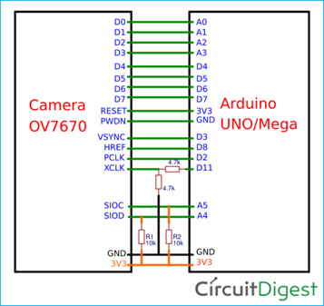
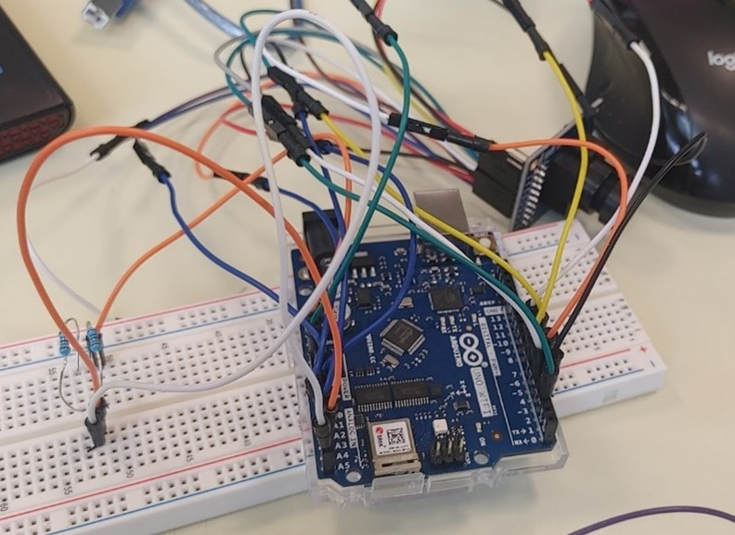
Hardware Integration Challenges
Notes:
I had never worked with hardware before. I didn’t even know how to read circuit diagrams properly. And by the time I attempted to wire up the camera, I realized too late that I didn’t have the right resistors on-hand. Due to time constraint I had to abandon this functionality.

Slide 7
Demo

Slide 8

Questions?

Slide 9
Student Name: Alex Paquette
Student Number: C00302989
Supervisor: Dr. Oisin Cawley
Institution: South East Technological University
Project Name: Energy Insight Hub
GitHub Repo: https://github.com/apaquette/Meter-Reader

Slide 10
References
Circuitdigest.com. (2019). How to Use OV7670 Camera Module with Arduino Uno. [online] Available at: https://circuitdigest.com/microcontroller-projects/how-to-use-ov7670-camera-module-with-arduino.
Auerswald, E. (n.d.). Seven Segment Optical Character Recognition. [online] Available at: https://www.unix-ag.uni-kl.de/~auerswal/ssocr/index.html.
n.a., (n.d.) [Online]. https://blacklionhvac.com/wp-content/uploads/electrical-meter.jpeg (Accessed November 2023).
Paredes, J. (2017). Add WiFi to Arduino UNO. [online] Instructables. Available at: https://www.instructables.com/Add-WiFi-to-Arduino-UNO/.
Harper, H.J. (2023). Enable Ping Windows 10: How to Set Up Firewall to Allow It. [online] Windows Report. Available at: https://windowsreport.com/enable-ping-windows-10/.
Rick-Anderson (2023). Host ASP.NET Core on Linux with Nginx. [online] learn.microsoft.com. Available at: https://learn.microsoft.com/en-us/aspnet/core/host-and-deploy/linux-nginx?view=aspnetcore-8.0&tabs=linux-ubuntu.
SulNR (2015). Process.Kill() doesn’t seem to kill the process. [online] Stack Overflow. Available at: https://stackoverflow.com/questions/30249873/process-kill-doesnt-seem-to-kill-the-process.

